Slide 1

Fit Fusion
ZACH COOK
BECKY FELTMAN
JORDAN HEERSINK
WILL KALISH
SILVIA REYES

Slide 2
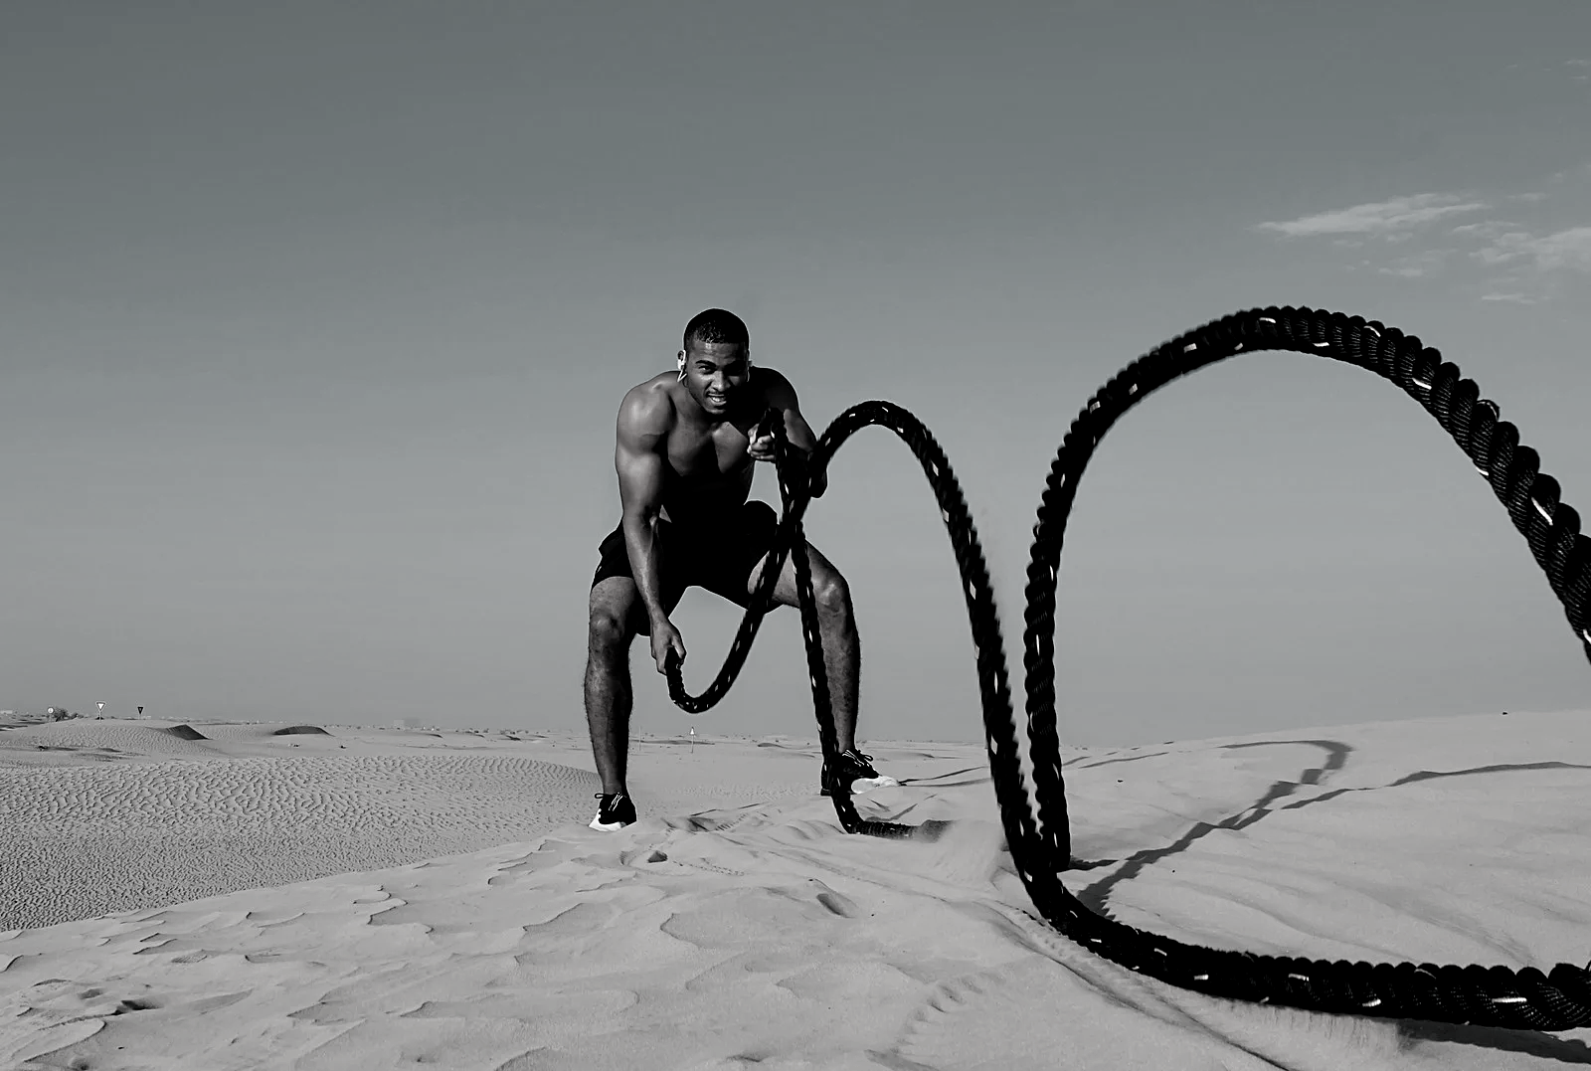


Elevator Pitch

Slide 3

Concept
DESCRIPTION
MOTIVATION
USER STORY
AS A person who likes to exercise
A mobile application that is used to create workout plans, search exercises, and track progress.
Create a mobile exercise experience that eliminates the financial barrier to entry.
I WANT a free app that I can use on my phone
SO THAT I can plan my daily workouts by searching a list of exercises, viewing descriptions and instructional gifs, and adding those exercises to my workout plan; keep track of my progress over time by setting goals and completing them; and stay up-to-date on the latest health-and-wellness related content.

Slide 4







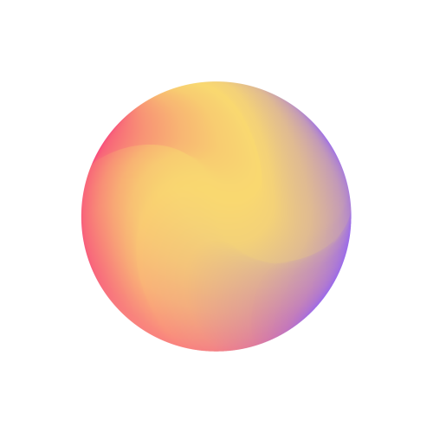










Process
Technologies Used
Breakdown of Tasks
Challenges
Successes
1
Front End
React Native CLI vs expo
Instant Preview
Becky - Silvia
run concurrently
Analytics and Debugging
EAS CLI
Back End
2
EAS SUBMIT
i18n internationalization
Learning a New Technology
William - Jordan
Limited Native Modules
Cross-Platform Compatibility
3
Workout Creation and Documentation
file size - Deployment
daily meetings- team work
Zach

Slide 5
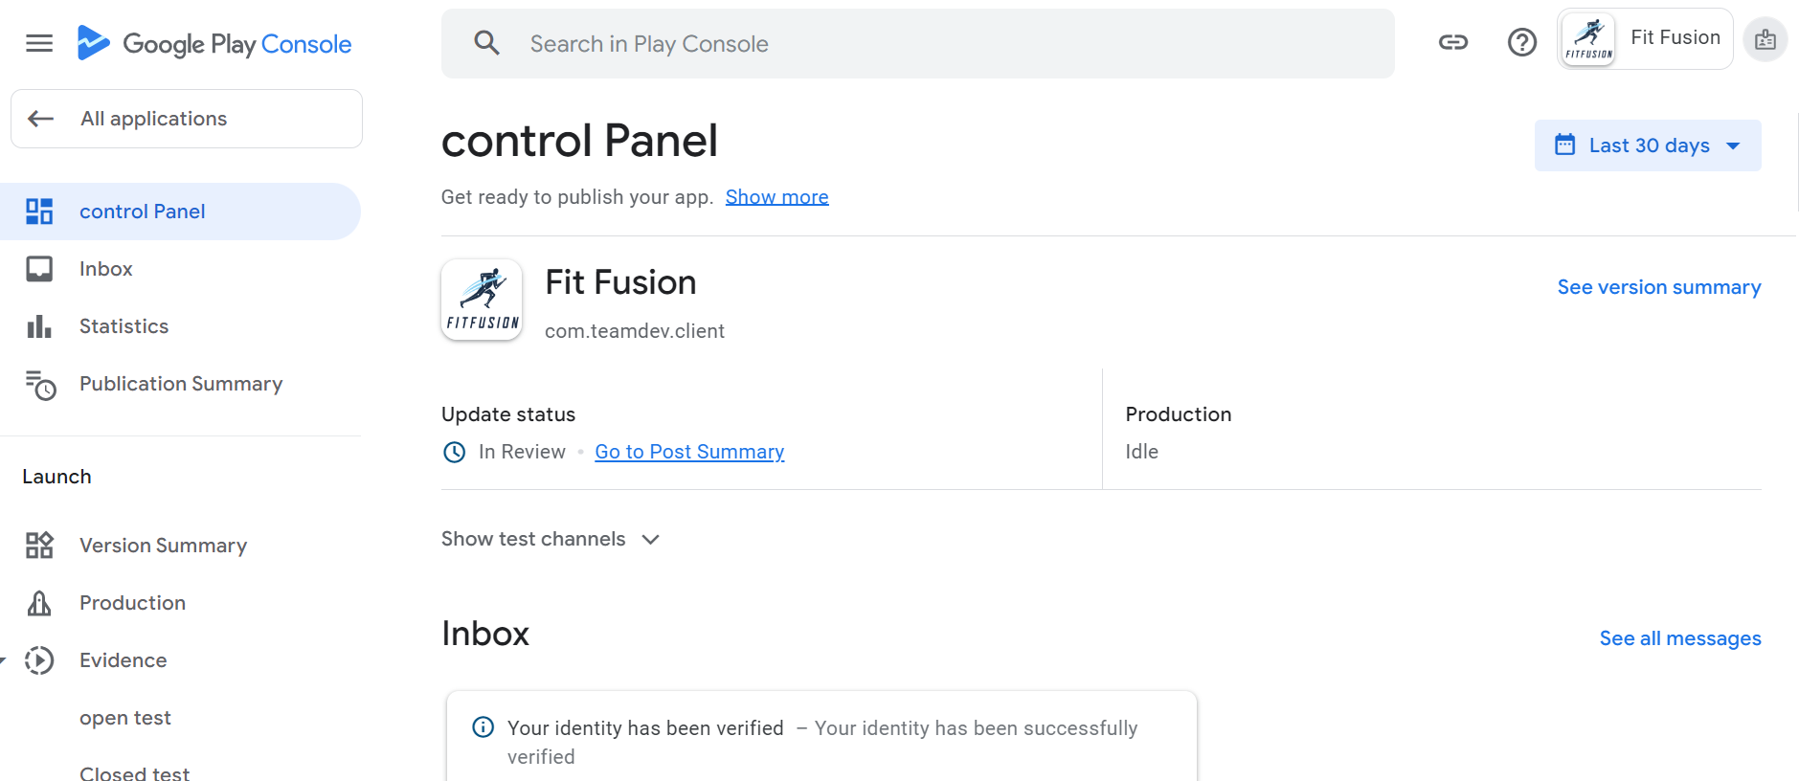
Deployment

Slide 6

Demo

Slide 7

Directions for Future Development
FINALIZE DEPLOYMENT
IMPLEMENT THE FORGOT PASSWORD AND STRIPE FUNCTIONALITY
ACCESSIBILITY CONSIDERATIONS
SOCIAL FEATURES
REAL-TIME WORKOUT TRACKING
CLICKABLE BODY MODAL
MOTIVATIONAL MESSAGES
LIGHT AND DARK THEME
USER-GENERATED BLOG POSTS

Slide 8
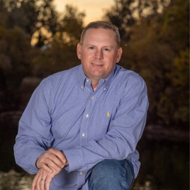
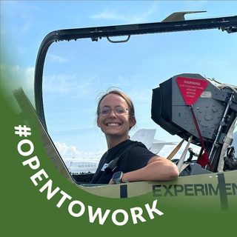
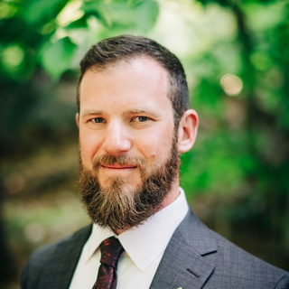
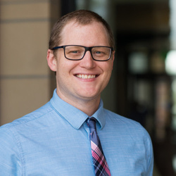
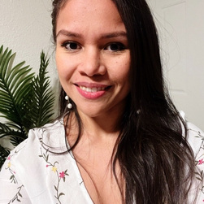
The Team
Zach Cook
Becky Feltman
William
Kalish
Jordan
Heersink
Silvia Reyes

Slide 9




Thank
You
HTTPS://GITHUB.COM/BECKPULL/FITFUSION

